Slide 1
Financing Healthcare Power BI Project

Slide 2
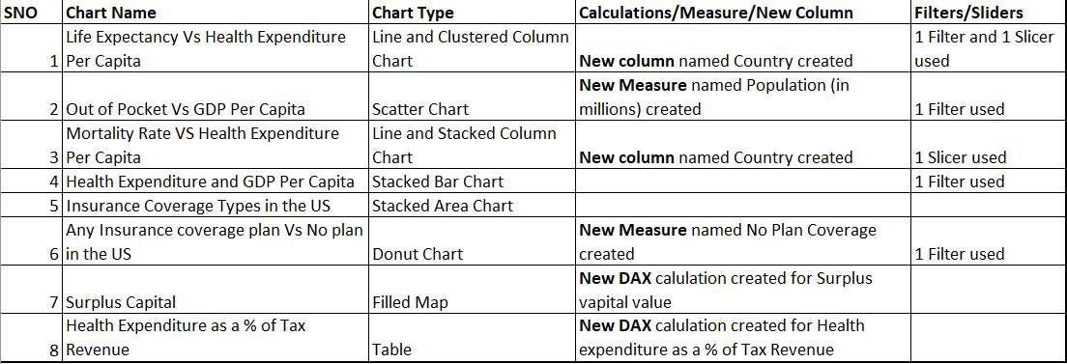
Data and Charts

Slide 3
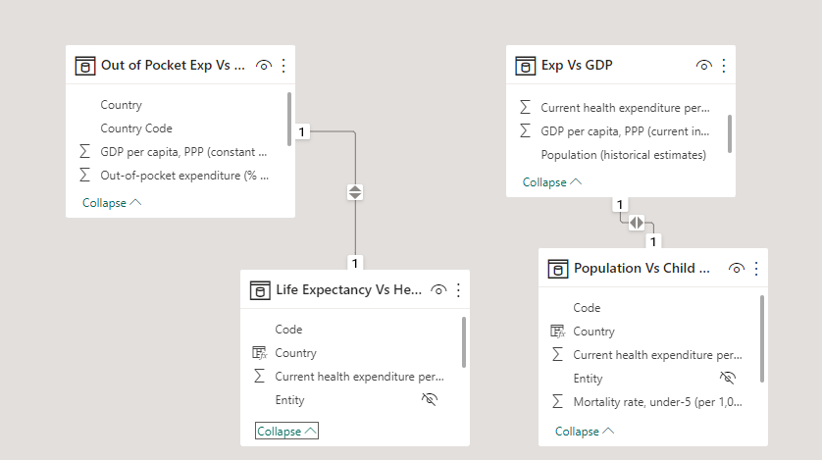
Relationships

Slide 4
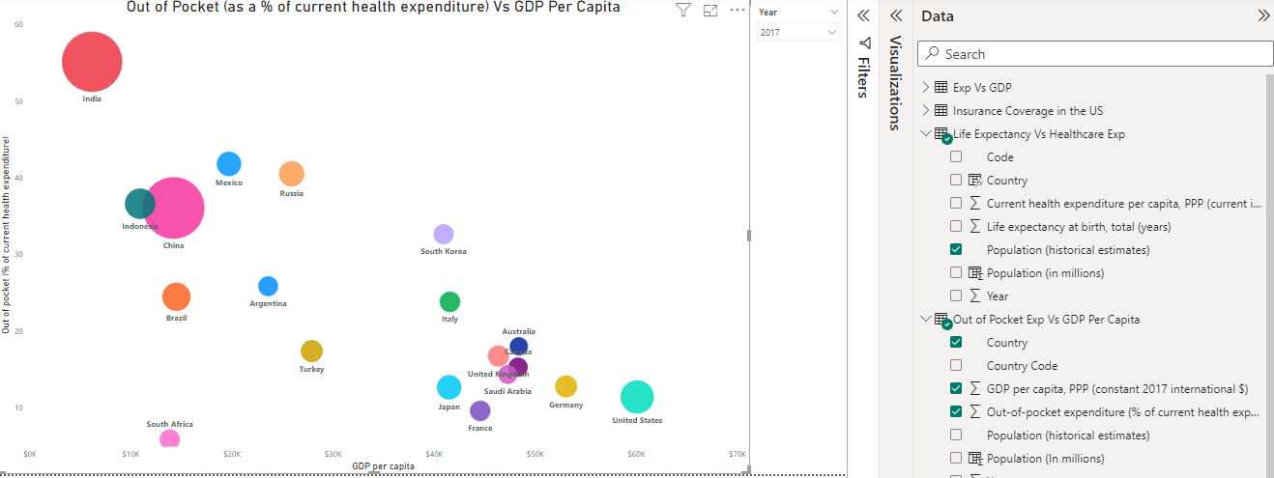
Relationships
I have created relationship between two data sets based on the population estimates.

Slide 5
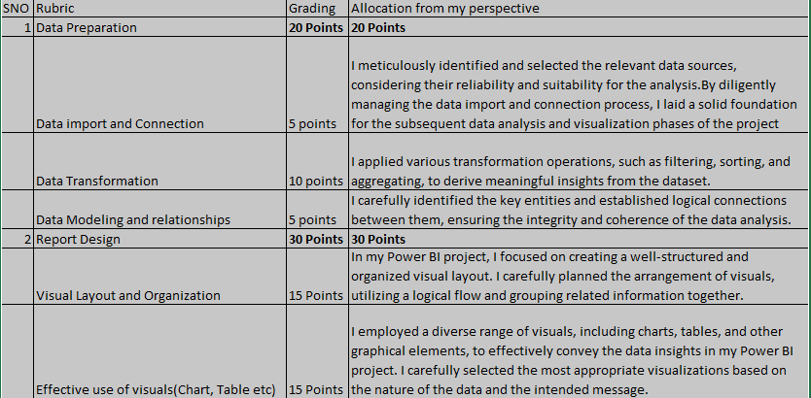
Grading Rubric

Slide 6
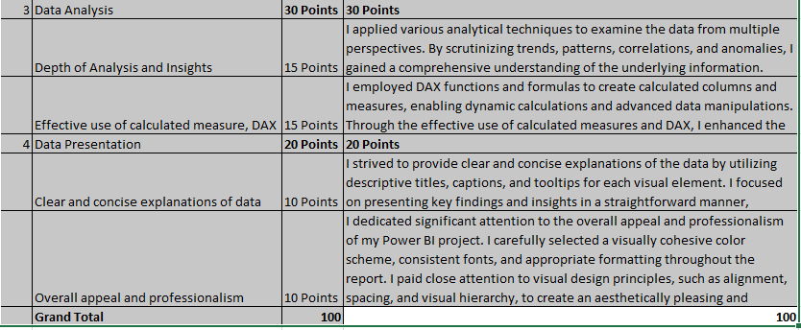
Grading Rubric

Slide 7
Link to the Project
Power BI Project workbook link - https://app.powerbi.com/groups/me/reports/5685c696-2ec6-451c-901f-4f8141d68d9d/ReportSection1a9392f6ca671a6cfa52?experience=power-bi
(or)
https://app.powerbi.com/links/h0dWvDvfus?ctid=7bd08b0b-3395-4dc1-94bb-d0b2e56a497f&pbi_source=linkShare

